Slide 1
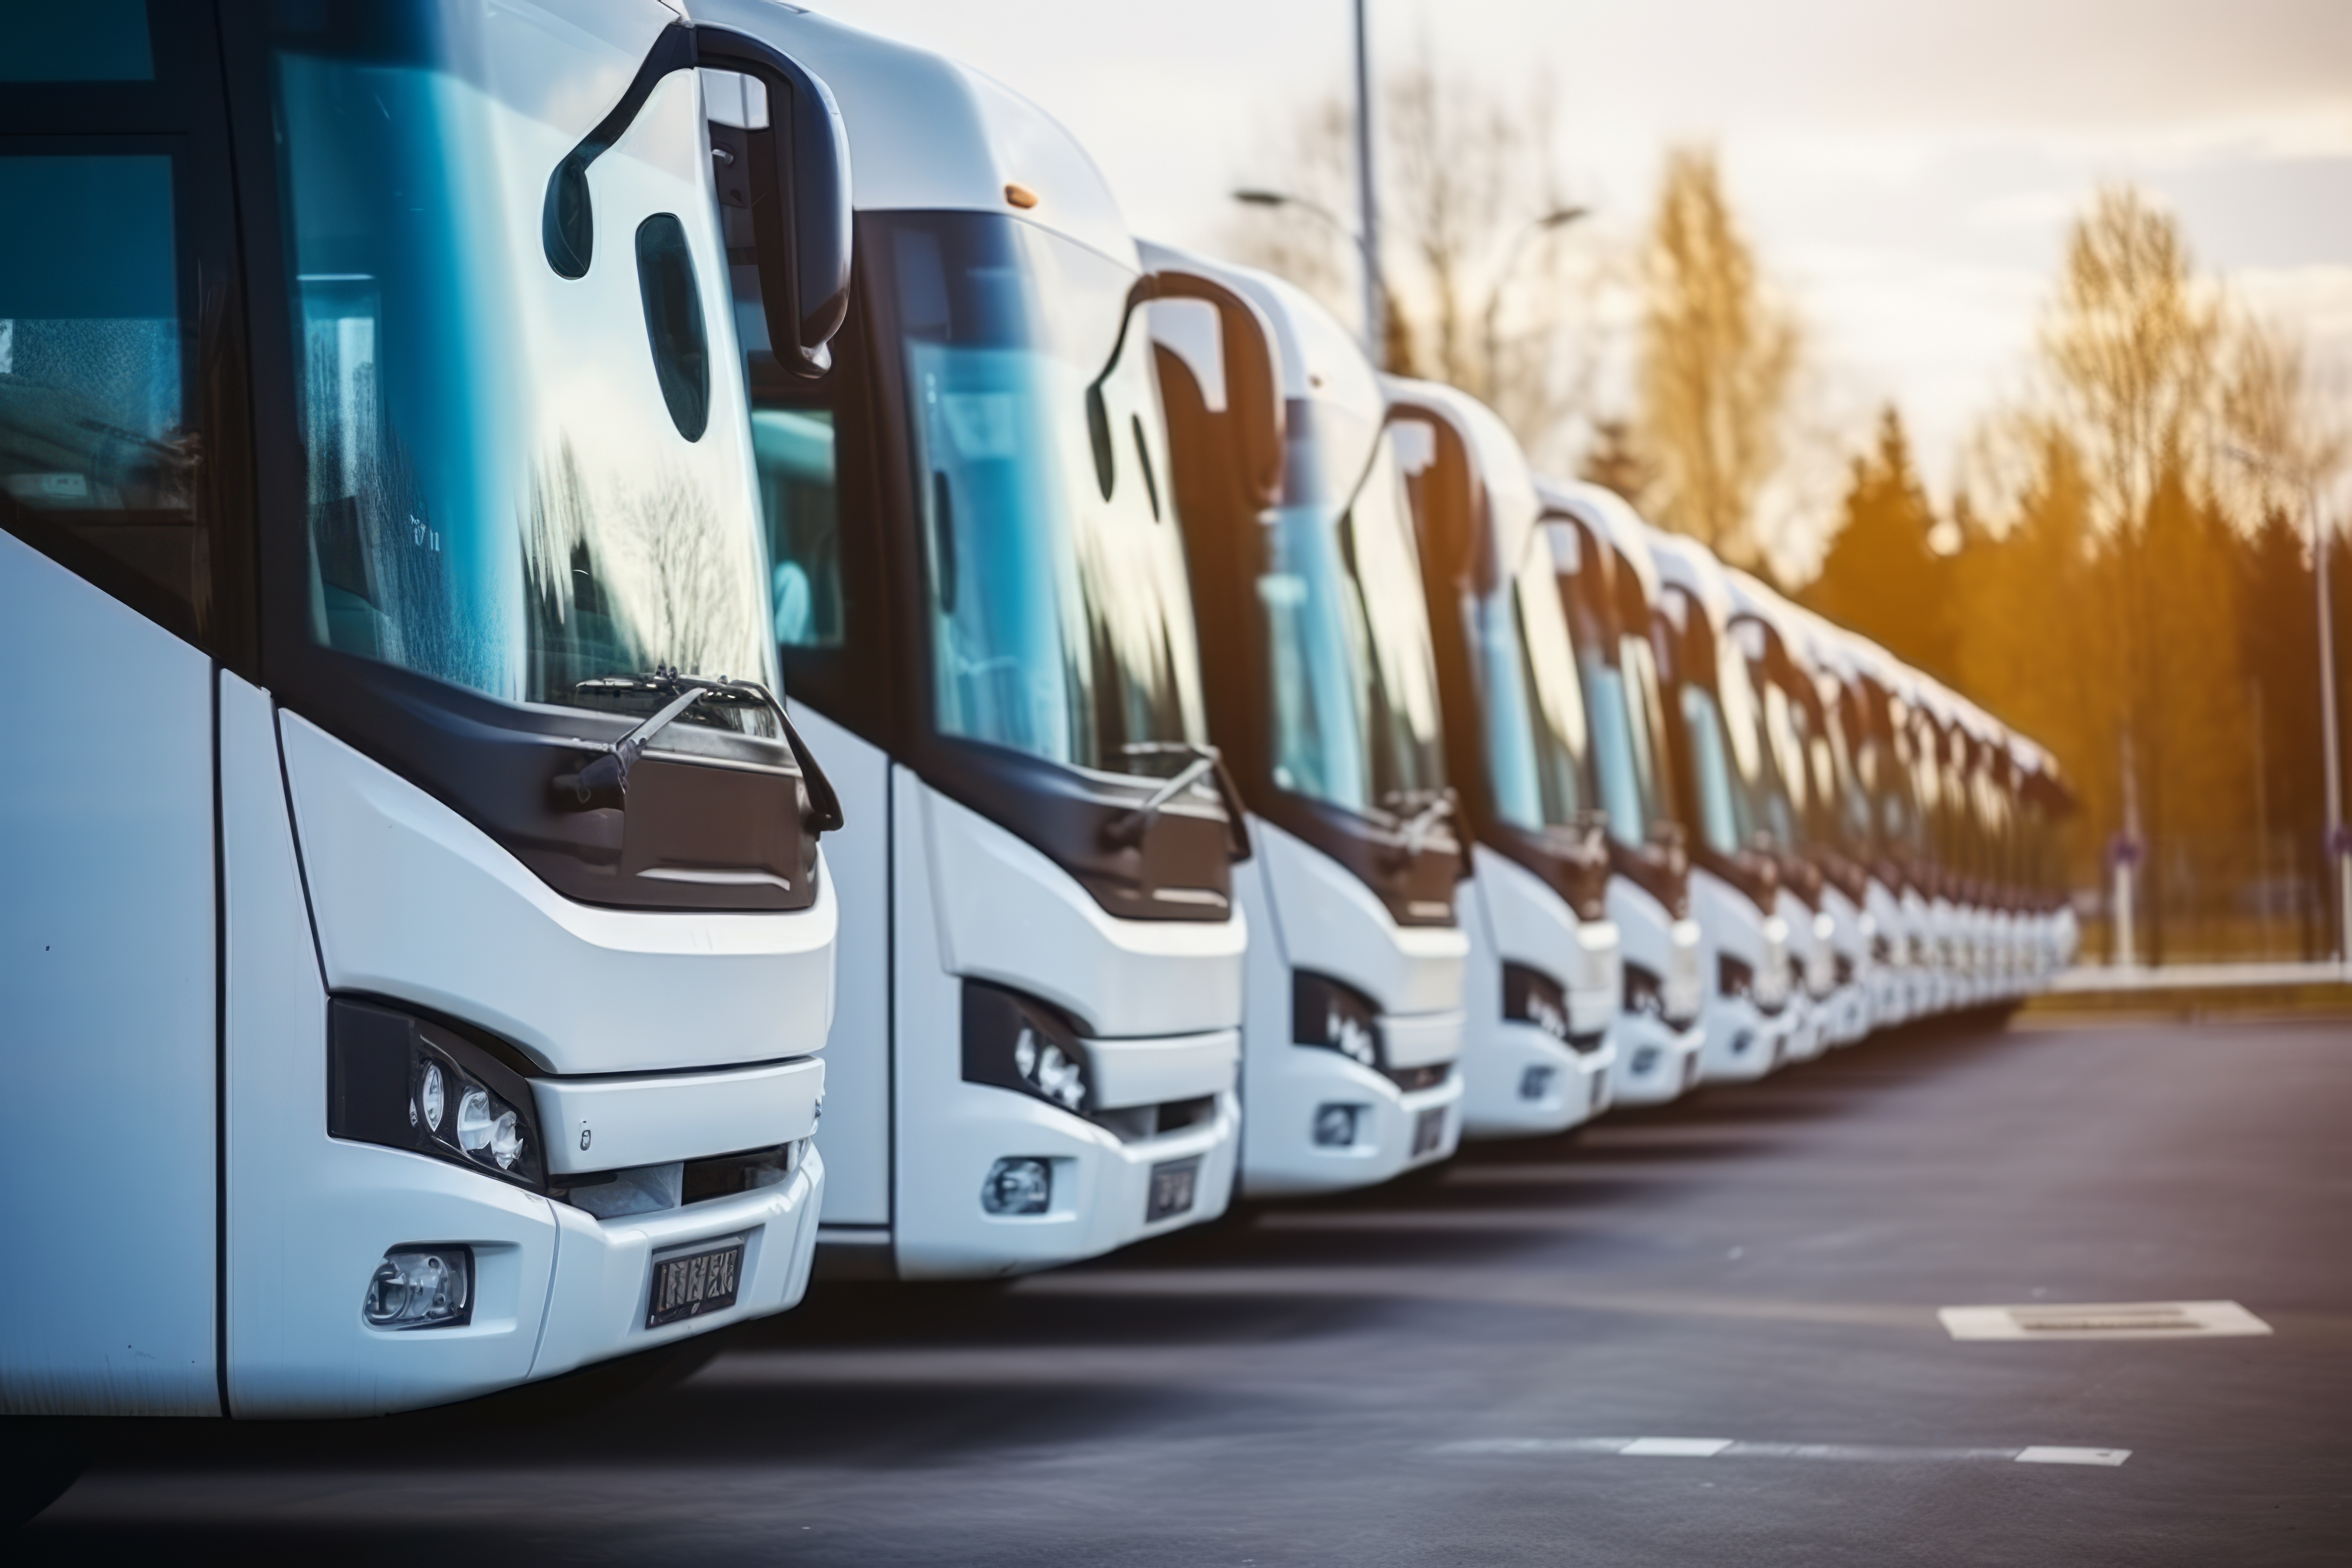


ELA and CORTE online information session on road transport social legislation for operators, drivers and social partners, with a focus on passenger transport
13 October 2025

Slide 2
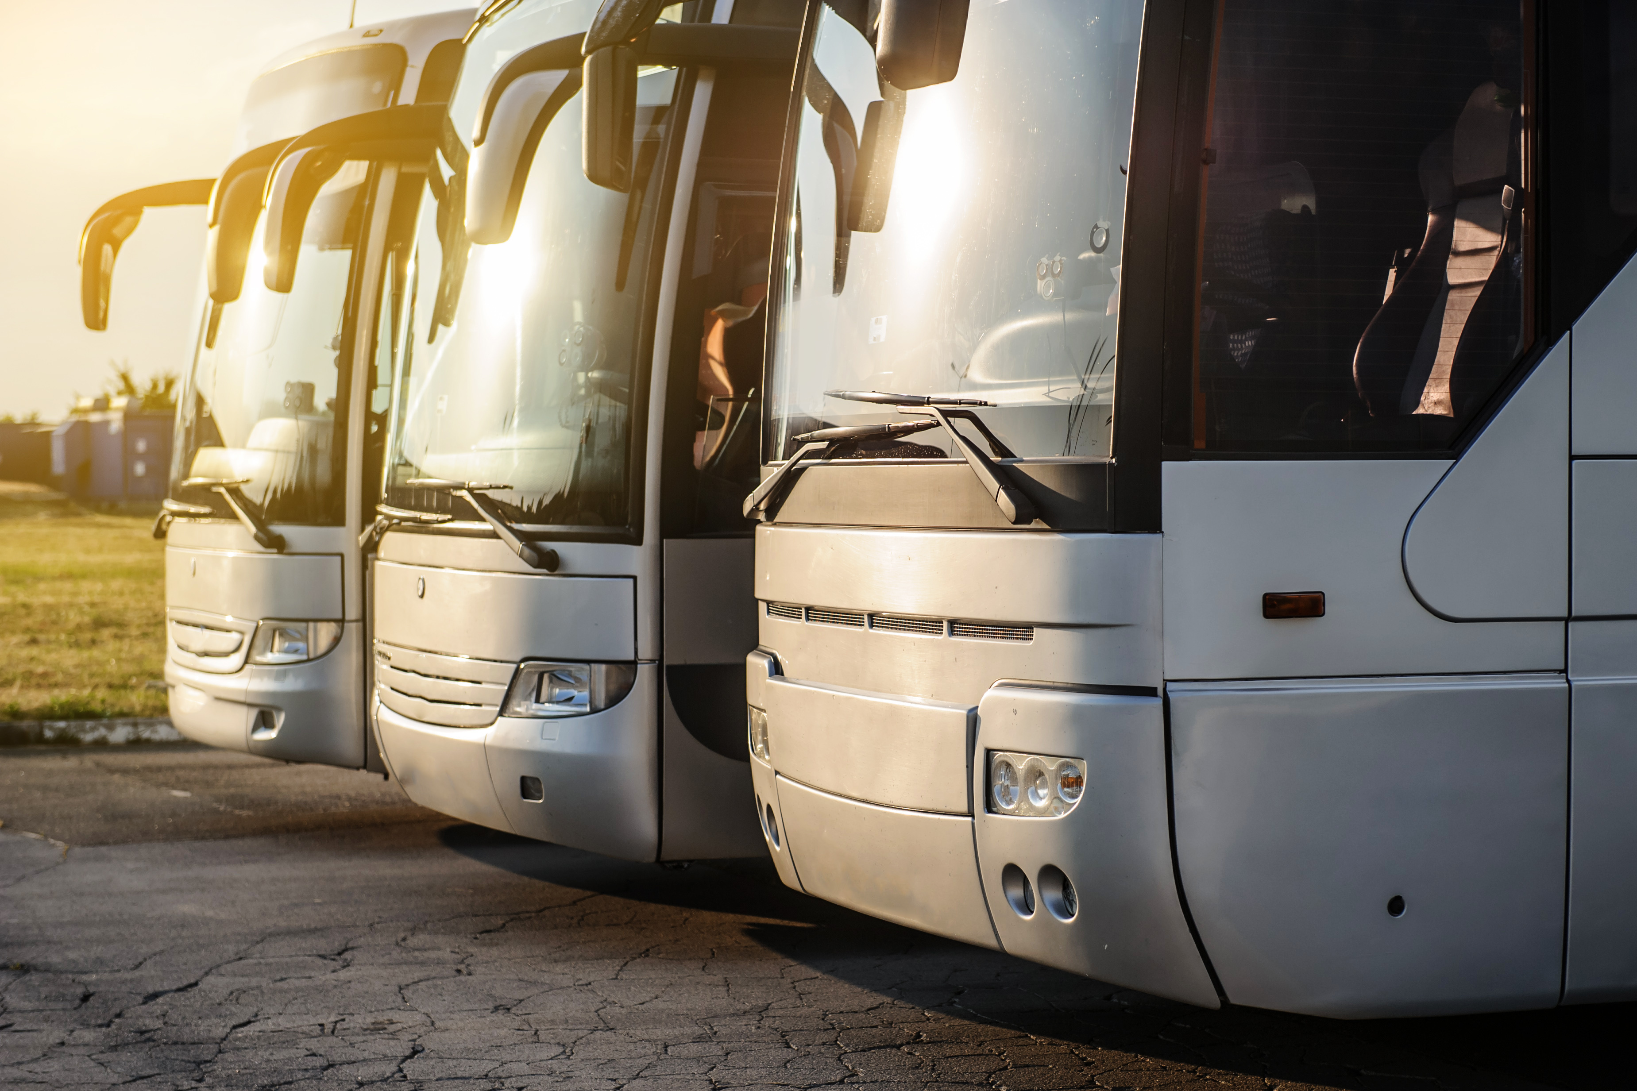
Opening remarks
Tonio BOER
Senior Labour Mobility Officer
Information and EURES Unit, ELA
Remy RUSSOTTO
Chief Executive Officer, CORTE
Katarzyna KUSKE
Policy Officer, DG MOVE,
European Commission

Slide 3
Agenda
09:30 – 10:00 | Registration (EEST time zone)
10:00 – 10:15 | Welcome words by ELA, EC and CORTE Tonio Boer, Senior Labour Mobility Officer, Information and EURES Unit, ELA Remy Russotto, Chief Executive Officer, CORTE Katarzyna Kuske, Policy Officer, DG MOVE, European Commission
10:15 – 10:25 | ELA information activities in the road transport sector Tonio Boer, Senior Labour Mobility Officer, Information and EURES Unit, ELA
10:25 – 10:55 | Driving and rest times in passenger transport Hans Drijer, Senior Expert, CORTE
10:55 – 11:10 | Experience from the side of drivers and operators by ETF and IRU
11:10 – 11:25 | Discussion
11:25 – 11:55 11:55 – 12:10 | Posting of drivers in passenger transport Artur Toczko, Road Transport Inspector, Provincial Road Transport Inspectorate in Białystok, Poland Coordination of social security systems (enforcement at the roadside) Danijela Wittine, Seconded National Expert, Cooperation Support Unit, ELA
12:10 – 12:25 | Experience from the side of drivers and operators by ETF and IRU
12:25 – 12:40 | Discussion
12:40 – 12:45 | Closing remarks by ELA Iwona Kasprzyk-Sowa, Senior Labour Mobility Officer, Cooperation Support Unit, ELA

Slide 4
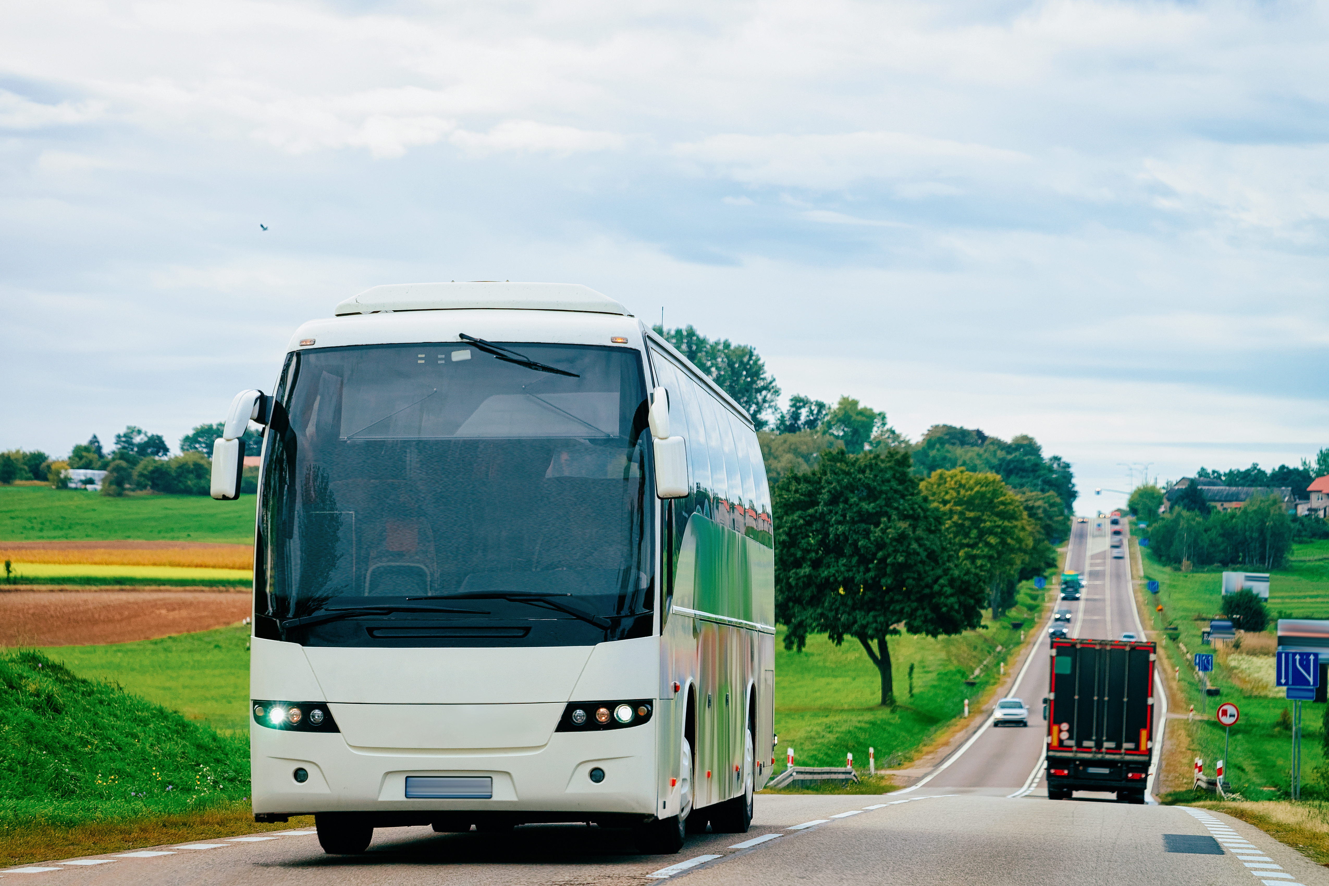
ELA information activities in
the road transport sector
Tonio BOER
Senior Labour Mobility Officer,
Information and EURES Unit, ELA

Slide 5
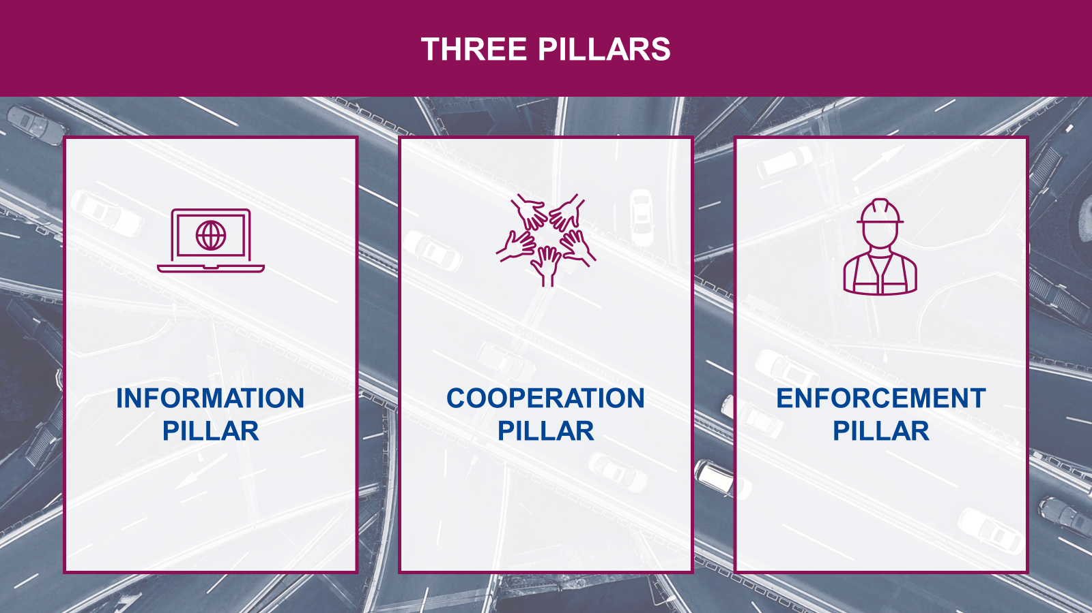

Slide 6
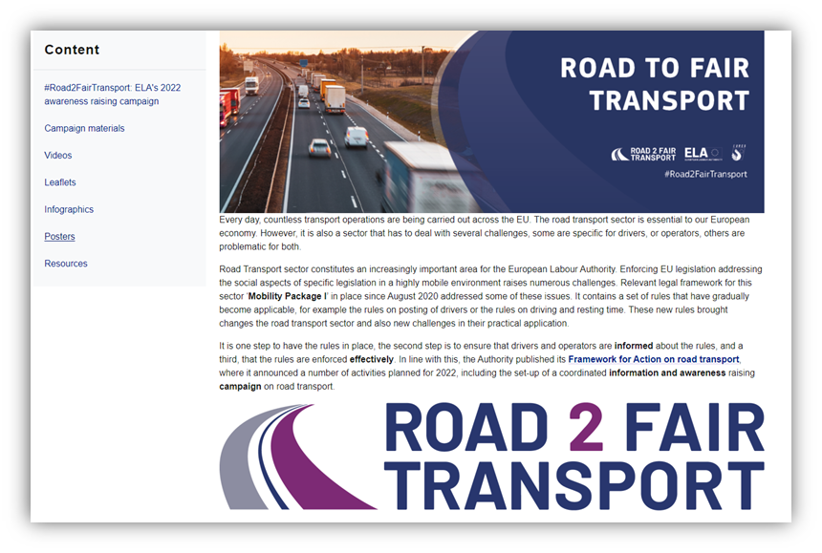
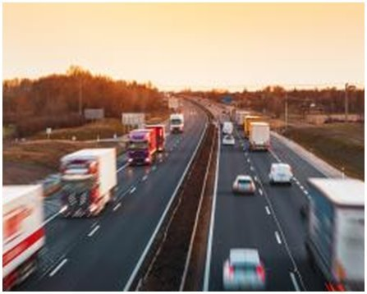
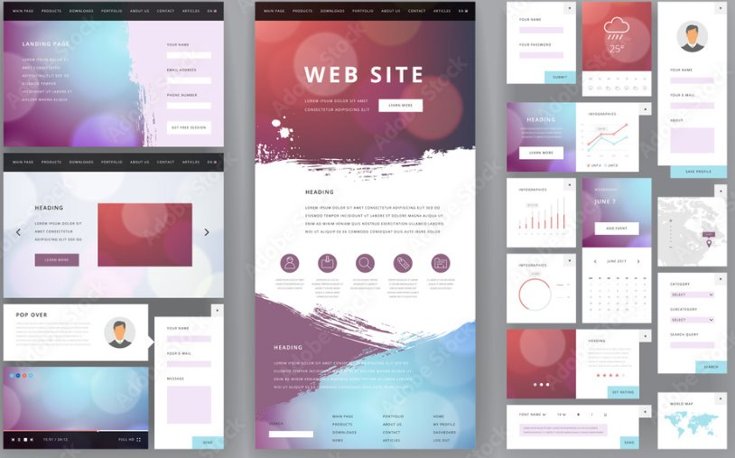

ELA Information Activities in the Road Transport Sector
Campaign
Road Transport Local Information events
Review of National Websites and EU portals
Notes:
Available in all EU languages
Campaign Materials
Videos
Leaflets
Infographics
Posters
Resources

Slide 7
ELA’s light commercial vehicles (LCVs) information and awareness-raising campaign
Campaign thematic scope: Rules applicable to LCVs as of 1 July 2026
Driving and rest time rules
Use of smart tachographs version 2 (G2V2)
Posting of drivers rules
Campaign target audience:
Drivers of light commercial vehicles (LCVs) engaged in international carriage of goods
  or cabotage
Operators of light commercial vehicles (LCVs) engaged in international carriage of goods or cabotage
Campaign output & material:
Leaflets, posters, dedicated landing page on ELA’s website: www.ela.europa.eu
Information webinar for LCVs drivers and operators – December 2025: https://www.ela.europa.eu/en/events
Campaign
Notes:
Available in all EU languages
Campaign Materials
Videos
Leaflets
Infographics
Posters
Resources

Slide 8

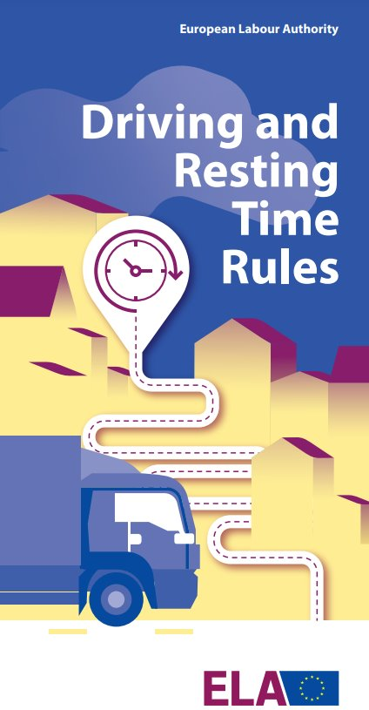



Information Resources in the Road Transport Sector
Available in all EU languages and several non-EU languages
Notes:
Your Europe logo has a hyperlink to the page on “EU rules for working in road transport” add link

Slide 9
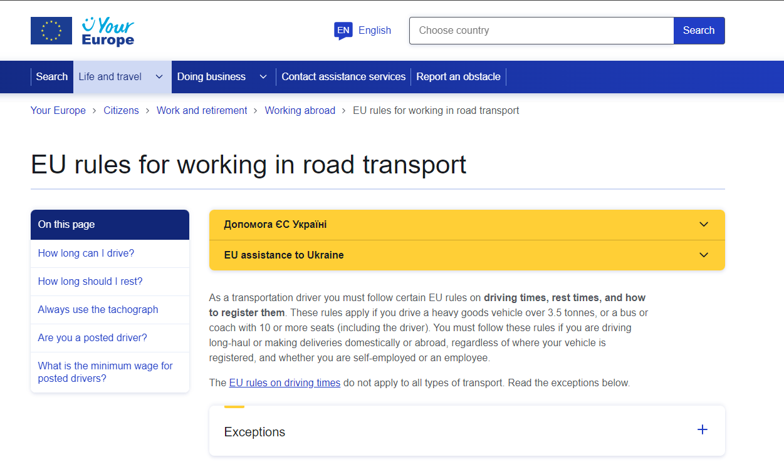
Information Resources in the Road Transport Sector
https://europa.eu/youreurope/citizens/work/work-abroad/rules-working-road-transport/index_en.htm
Notes:
Your Europe logo has a hyperlink to the page on “EU rules for working in road transport” add link

Slide 10
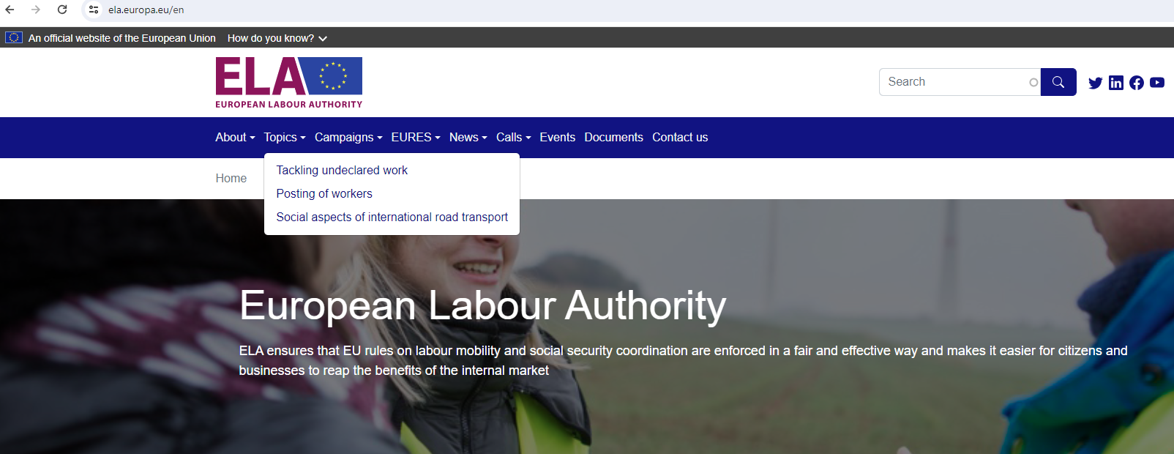
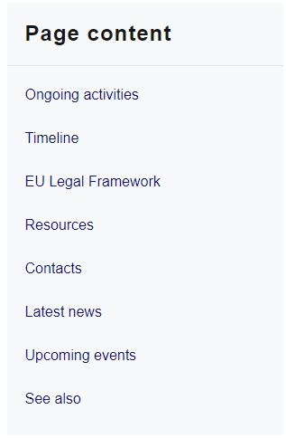
Information Resources in the Road Transport Sector
https://www.ela.europa.eu/en/social-aspects-international-road-transport

Slide 11
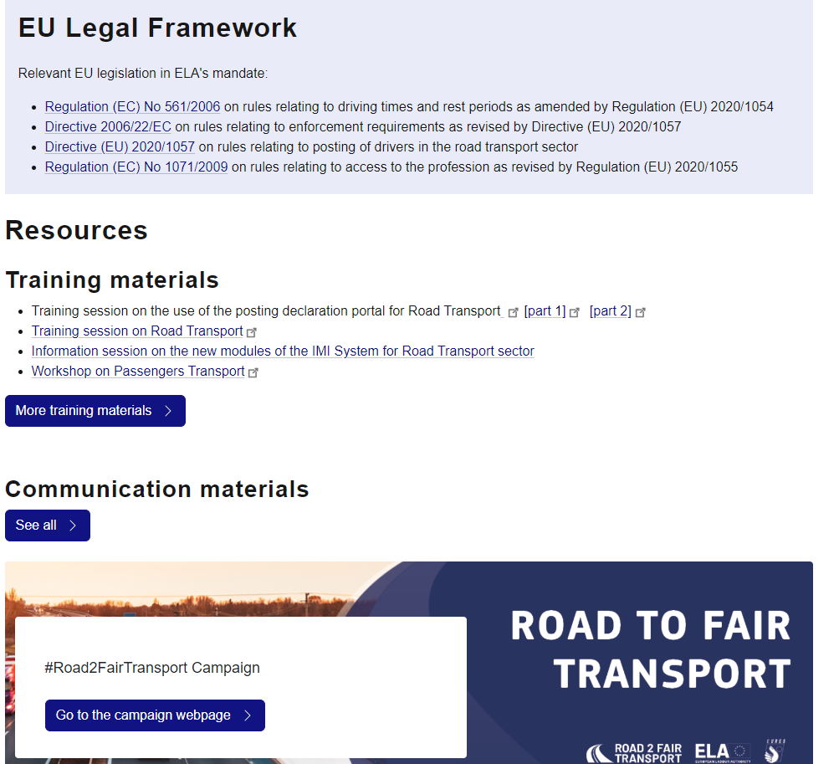
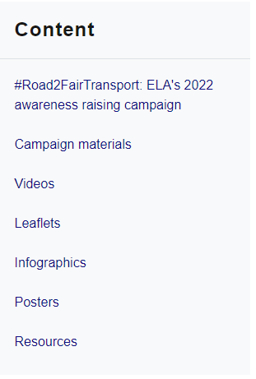

Information Resources in the Road Transport Sector

Slide 12
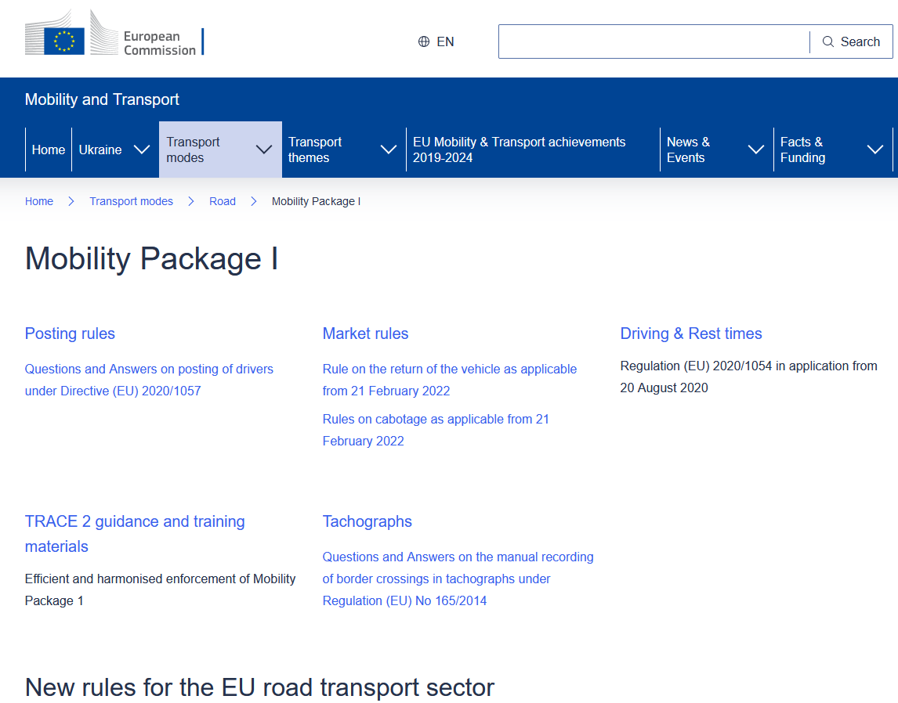
Information Resources in the Road Transport Sector
https://transport.ec.europa.eu/transport-modes/road/mobility-package-i_en

Slide 13
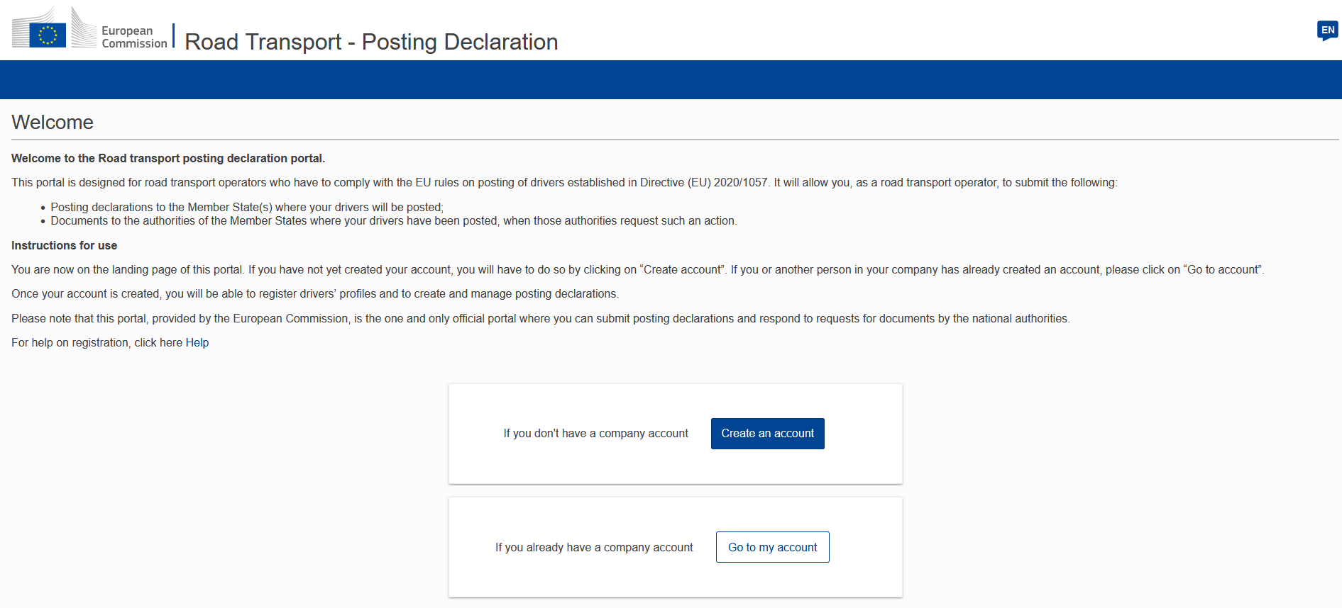
Other relevant Resources in the Road Transport Sector
https://www.postingdeclaration.eu/landing

Slide 14

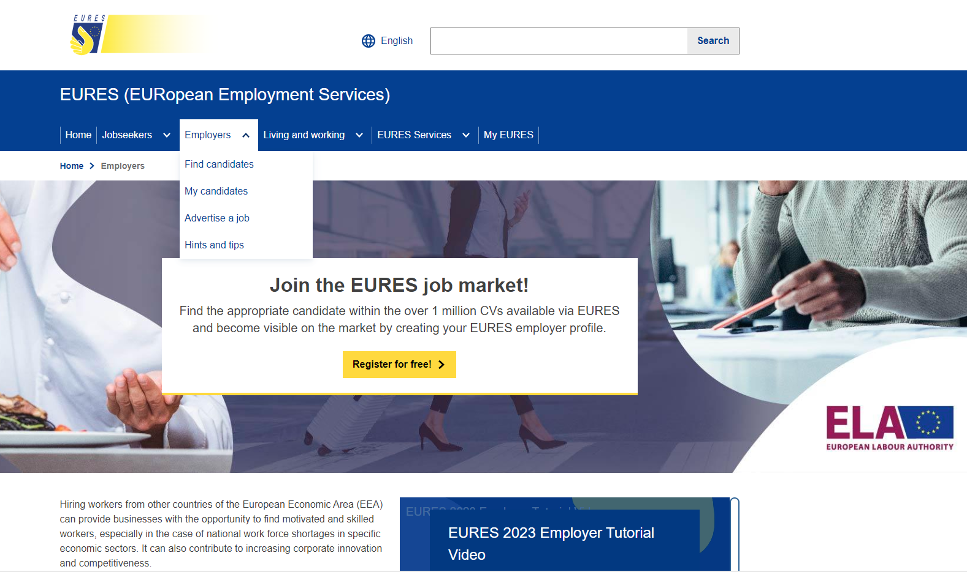
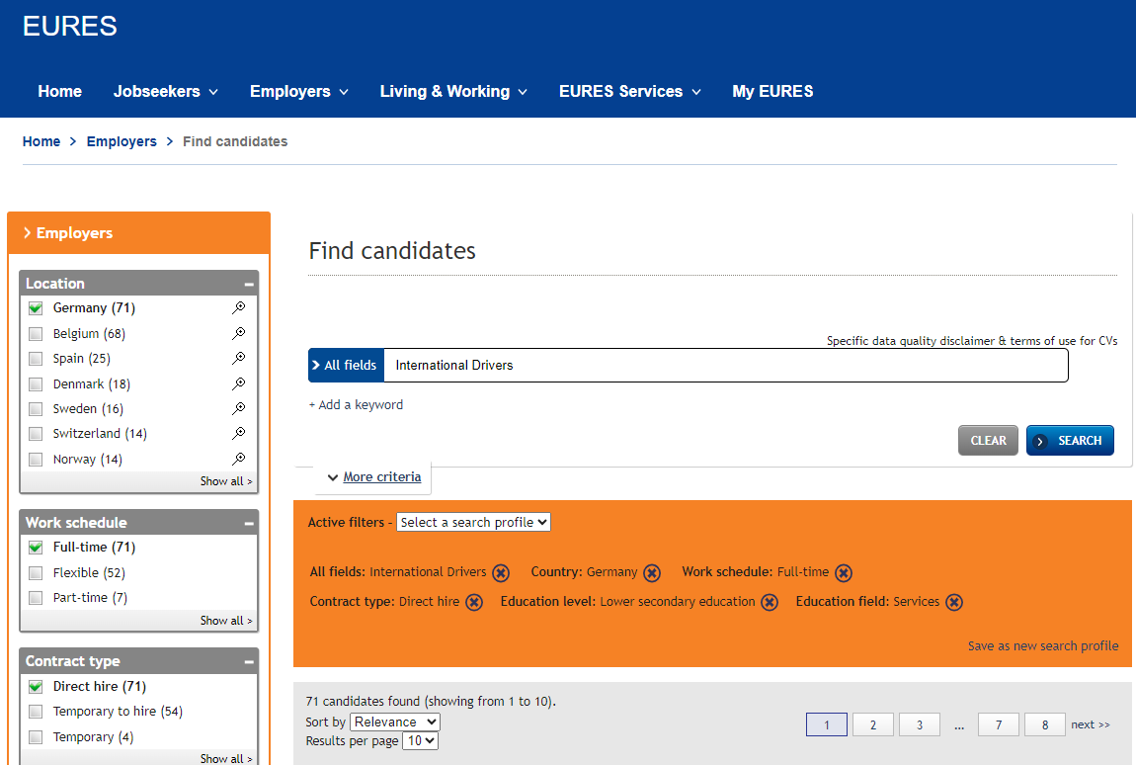
Other relevant Resources in the Road Transport Sector
Finding skilled workers in international road transport
https://eures.europa.eu/employers_en
Step 1 - homepage
Step 2 – find candidates (for employers)

Slide 15
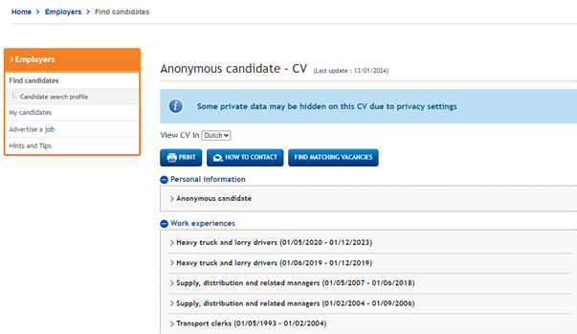
Other relevant Resources in the Road Transport Sector
Prerequisite
Relevant Links
EU Login
EURES Login as employer
https://eures.europa.eu/employers_en
EURES Employer Tutorial 2023
Step 3 – candidate CV
Notes:
Your Europe logo has a hyperlink to the page on “EU rules for working in road transport” add link

Slide 16
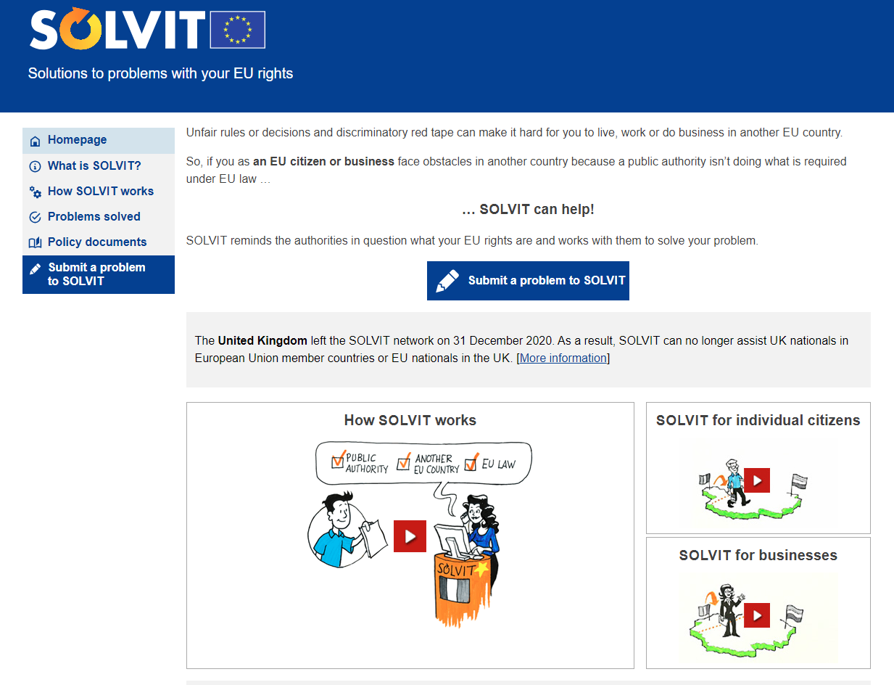
Other relevant Resources in the Road Transport Sector
https://ec.europa.eu/solvit/index_en.htm
Notes:
Your Europe logo has a hyperlink to the page on “EU rules for working in road transport” add link

Slide 17



Thank you!
information@ela.europa.eu
www.ela.europa.eu

Slide 18
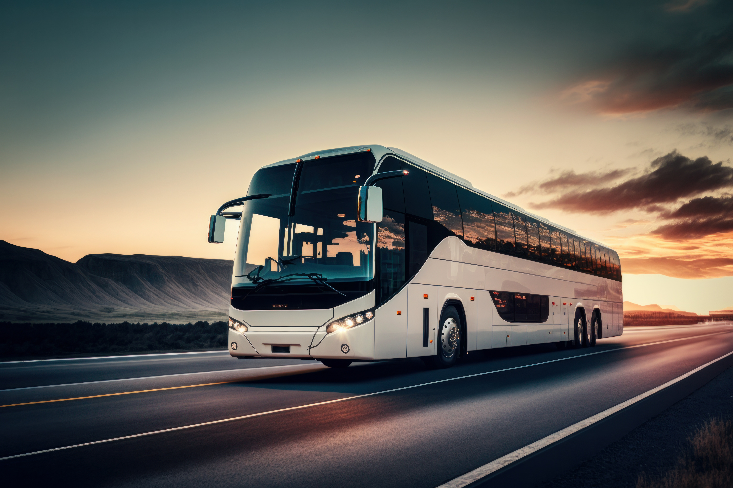
Online information session on the changes introduced to driving & rest times in occasional passenger transport - Regulation (EC) 561/2006
 | Hans DRIJER, CORTE

Slide 19
New rules for occasional passenger transport - Regulation (EU) 2024/1258
BACKGROUND
Specificities of the occasional passenger transport, in comparison to regular/freight transport justifying recently adopted derogations:
High seasonality
Generally involves less driving time compared to freight transport or regular bus services
Varying driving distances
Unscheduled and impromptu requests for additional stops, for changes of the route or schedule where feasible
Drivers usually sleep in hotels and seldom drive at night

Slide 20
New rules for occasional passenger transport - Regulation (EU) 2024/1258
BACKGROUND
Mobility Package I required the European Commission to examine whether more appropriate rules can be adopted for drivers engaged in the occasional passenger transport due to the specificity of the sector:
The new rules, under Regulation 2024/1258 were adopted on 24 April 2024 and entered into force on 22 May 2024

Slide 21
Derogations for Occasional Passenger Transport (*international + national)
New derogations:
  1. Breaks - Splitting the 45-minute break
2. Daily rest - Extension of the ‘period of 24 hours’
under certain conditions
Extension of existing derogation to national occasional transport:
3. Weekly rest - The '12-day derogation' extended to national transport

Slide 22
1st new derogation: BREAKS Splitting of the 45-minute break
Inserted in art.7 (3) of Reg.561/2006
“ (…) For a driver engaged in an occasional passenger service, the break referred to in the first paragraph may also be replaced by two breaks, of at least 15 minutes each, distributed over the driving period referred to in the first paragraph, in such a way as to comply with the provisions of the first paragraph (…) ”.

Slide 23
Splitting of the 45-minute break
General Rule: (all drivers of freight and/or passenger transport)
15minutes (at least) + 30minutes (at least)
Derogation: (only applies to occasional passenger transport)
Permits the driver to split the 45-minute break into any combination (such as 20 + 25; 17 + 28; 30 + 15 etc.)
1st break
at least 15 min
2nd break
at least 30 min
45 mins
The combination
should result in
at least a 45 mins
break
1st break
at least 15 min
2nd break
at least 15 min

Slide 24



General Rule: Splitting of 45 min. break
(all drivers of freight and/or passenger transport)
1h
15 min
3,5h
30 min
Allowed in all types of transport.
1st break of at least 15 minutes
2nd break of at least 30 minutes
Next calculation starts after the 2nd break of 30 min
The enforcement calculation is because of the Charlton case - C-116/92
Notes:
The calculation provided for by Article 7(1) of Regulation No 3820/85 begins at the moment when the driver sets in motion the recording equipment provided for by Regulation No 3821/85 and begins driving.
where a driver has taken 45 minutes' break, either as a single break or as several breaks of at least 15 minutes during or at the end of a four-and-a-half hour period, the calculation provided for by Article 7(1) of the regulation should begin afresh, without taking into account the driving time and breaks previously completed by the driver.

Slide 25
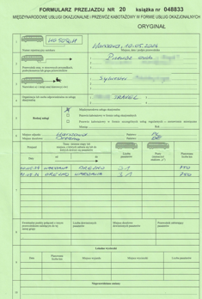
Derogation for occasional passenger transport - additional option for splitting the 45-minute break
1h
25 min
3,5h
20 min
Allowed only occasional passenger transport.
1st break of at least 15 minutes
2nd break of at least 15 minutes
In occasional passenger transport next calculation starts after the 2nd break of 20 min

Slide 26
Derogation for occasional passenger transport - additional option for splitting the 45-minute break
5 min
30min
4h 25min
15 min
4h 30min
Allowed only in occasional passenger transport.
In occasional passenger transport next calculation starts after the 2nd break of 15 min

Slide 27



Splitting of the 45 min break – comparison between the general rule and the derogation
10 min
30 min
4 h
15 min
4 h
30 min
In transport of goods and
regular passenger transport
next calculation starts after
the 2nd 30 min break,
and constitutes an infringement.
In occasional passenger transport next calculation starts after the 2nd break of 15 min
The wiping of slate clean differs between occasional passenger transport and goods transport/regular passenger transport

Slide 28
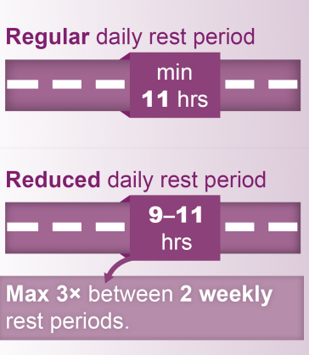

DAILY REST - Recap of the general rule
24h period
daily period of activity of the driver
13 h
15 h

Slide 29

2nd derogation – extension of the 24h period
next daily period
of activity of the driver
daily period
of activity of the driver
daily or weekly rest
13 h
REGULAR DAILY REST
11 h
24 h
next daily period
of activity of the driver
daily period
of activity of the driver
daily or weekly rest
14 h
REGULAR DAILY REST
11 h
25 h

Slide 30
2nd derogation – extension of the 24h period
next daily period
of activity of the driver
daily period
of activity of the driver
daily or weekly rest
15 h
REDUCED DAILY REST
9h
24 h
next daily period
of activity of the driver
daily period
of activity of the driver
daily or weekly rest
16 h
REDUCED DAILY REST
9h
25 h

Slide 31
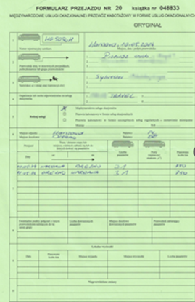
2nd derogation: extension of 24-hour period
Conditions
max. 7h
next period
of daily activities
daily or
weekly
rest period
min. 9 h
max. 25h
Additional conditions:
Nature of transport
single occasional passenger service
Daily driving time
limited to 7h
Permissible number of times of use
Length of the service | less than 6x24h | at least 6x24h and less than 8x24h | 8x24h or more
times of use | - | once | twice
x1
3h + 4h
e.g.

Slide 32
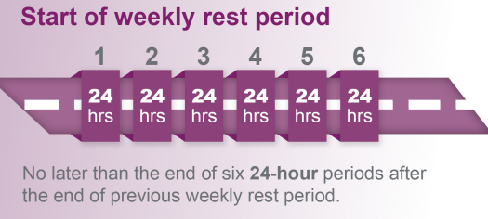
3rd derogation – the 12-Day derogation extended to national occasional transport
The 12-day derogation for occasional passenger transport refers to the postponement of a weekly rest period from 6 up to 12 consecutive 24-hour periods
From 22 May 2024 the 12- day derogation is extended to national occasional Passenger transport.
Up to…

Slide 33
12 Day derogation - conditions
The conditions to avail of the 12-day rule
It must be preceded by a regular weekly rest of at least 45 hours
After the use of the derogation the driver must take either two regular weekly rest periods (total 90 hours); or one regular weekly rest period and one reduced weekly rest period of at least 24 hours (total 69 hours)
Any reduction (of at most 21 hours) must be compensated by an equivalent period before the end of the third week following the end of the derogation period
Derogation not permitted with an analogue tachograph - A digital tachograph can be used in vehicles which are only engaged in national occasional services.
Single manned vehicle – driver is restricted to three hours of continuous driving time, before he must take a 45-minute break if he drives between 10pm and 6am
Notes:
Not meeting the conditions is not an infringement in itself. And a driver/company should not be penalized if, for example, the driver drives for 4 hours instead of 3 hours.

Slide 34

Occasional Passenger Transport
Art . 8.6a of Regulation 561/2006
regular
or
reduced*
weekly rest period
regular weekly rest period
regular weekly rest period
+
*if reduced, compensation is required
max. 12 periods of 24h
Additional requirements:
Tachograph | Nature of transport | Continuous driving at night
digital or smart | single occasional passenger service | limited to 3 hours, unless multi-manned
G1
G2V1
G2V2
x1
max. 3h
max. 4h 30min

Slide 35
Obligation to justify derogations
Drivers must be able to justify the use of the three derogations during roadside checks, by carrying on board a completed journey form
the journey form for international services may be used for national services, indicating its use for national service
Obligation to carry on board the vehicle, paper or electronic copies of journey forms covering the previous 28 days, and from 31 December 2024, the previous 56 days
Regulation (EU) 2024/1258,
Notes:
Article 7
Article 8.2a
Article 8.6a
article 16(4) of Regulation (EU) 561/2006

Slide 36
Update of Technical Specifications
The obligation to carry on board the vehicle copies of journey forms for previous 56 days ceases to apply at the latest when the vehicle uses a tachograph allowing the recording of the type of passenger service.
By 23 November 2025, the Commission is required to adopt implementing acts laying down appropriate technical specifications for tachographs to enable the recording and storage of data relating to the type of passenger service
Regulation (EU) 2024/1258, article 16(4)
Notes:
article 16(4) of Regulation (EU) 561/2006

Slide 37
Digitalization of a journey form - Timeline
By 31 December 2026, the Commission is required to assess the options for digitalizing the journey form for drivers engaged in occasional passenger services
Regulation (EU) 2024/1258, article 16(4)
Notes:
article 16(4) of Regulation (EU) 561/2006

Slide 38

Experience from the side of drivers and operators by ETF and IRU

Slide 39

Discussion

Slide 40
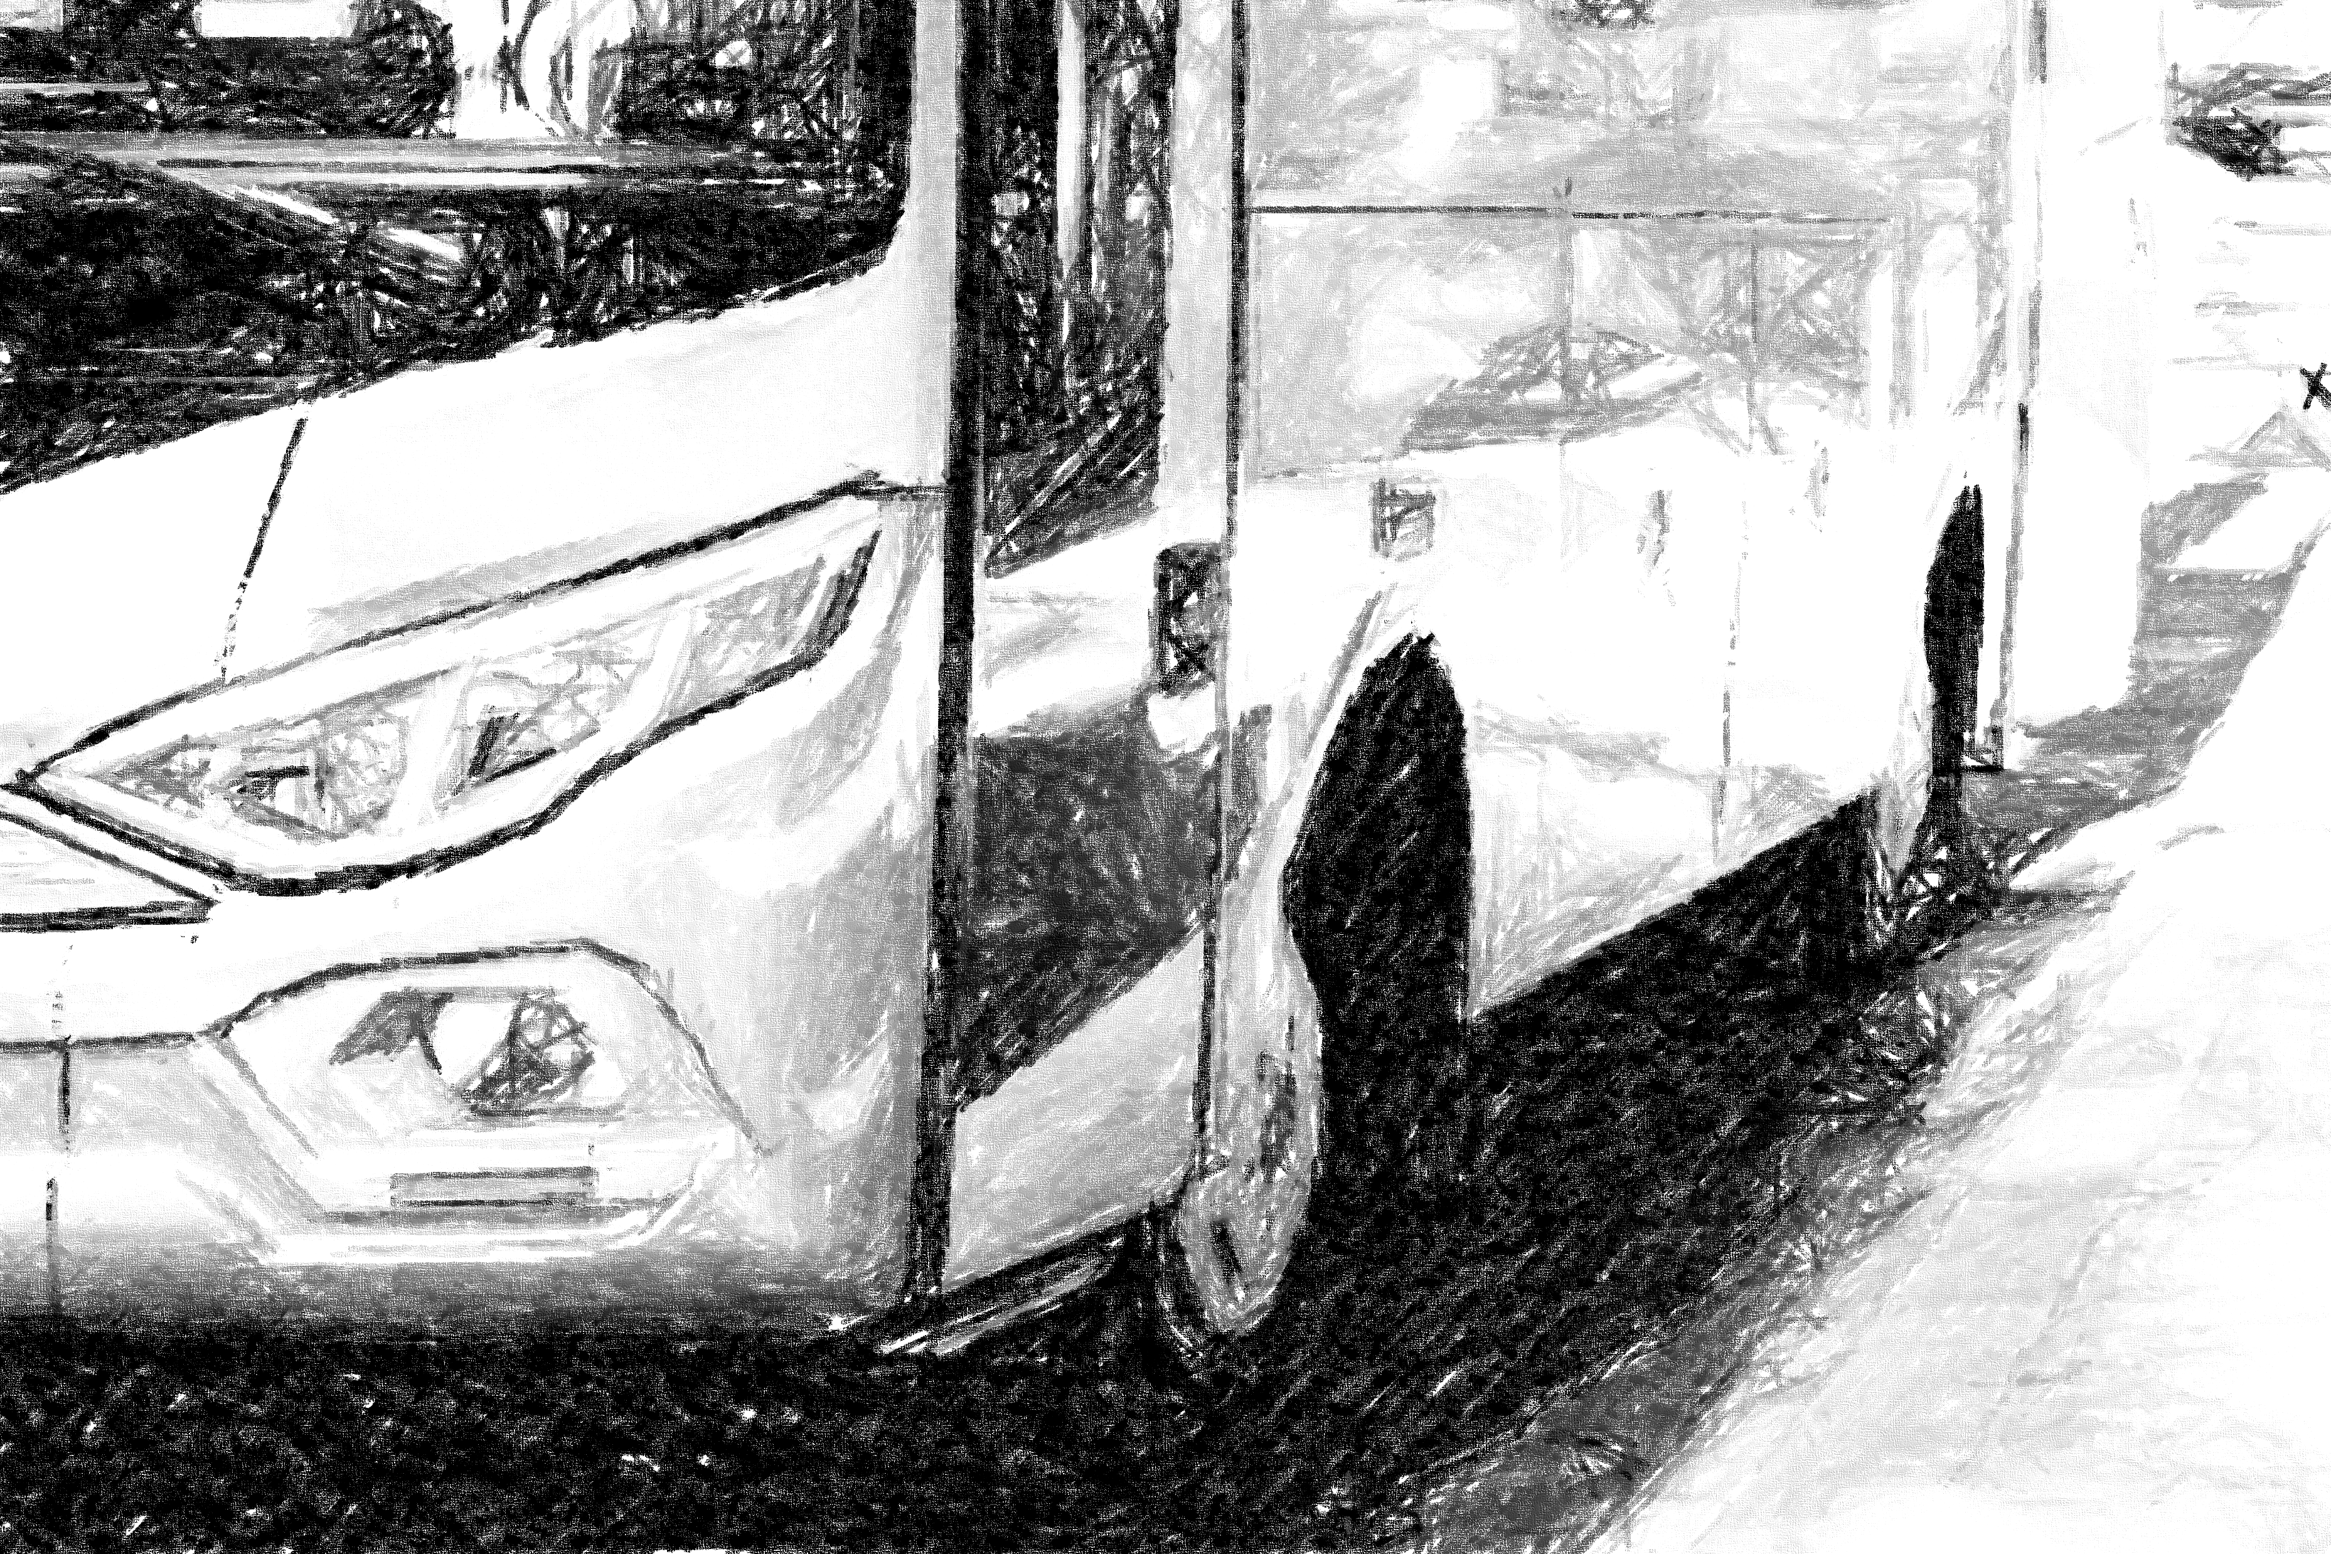
Online information session
on posting of drivers
in passenger transport
Artur TOCZKO
Road Transport Inspector
Poland

Slide 41


Overview of the posting rules
Type of operation | In posting | Out of posting
Cabotage
Bilateral operation
Cross-trade / Non bilateral operation
Bilateral operation + one activity of loading and/or unloading (1+1 rule)*
Bilateral operation + two activities of loading and/or unloading during return journey (0+2 rule)**
Bilateral operation as part of an initial or final leg of combined operation*
Non bilateral operation as part of an initial or final leg of combined operation*
Transit
Unladen journeys
*only with G2V2 tachograph
*transport of goods only
Notes:
Before we dive into the details of posting of drivers engaged in carriage of passengers, a quick reminder of the general rules of posting drivers

Slide 42
Unladen journeys
Is an unladen journey the same as ‘transit’?
No. A transit situation is always exempt from posting rules, while an unladen journey is exempt if it is carried out in connection with a bilateral operation and is not exempt when it is carried out in connection with cabotage or non-bilateral international operation falling under posting rules (cross-trade).
In principle, posting ends with unloading (setting down passengers) goods carried within the operation falling under posting rules (e.g. cabotage or cross-trade). The classification of the subsequent unladen journey as posting or as exempt from posting depends on whether the new operation, which actuates that unladen journey, is covered by posting rules or not. In this context, it is important to note, that the driver is not considered posted if, after unloading the goods (setting down passengers) within the operation covered by posting rules, he/she performs an unladen journey back to his/her MS of establishment.
Source: DG MOVE - Questions and Answers on posting of drivers under Directive (EU) 2020/1057
Notes:
If a journey with passengers or a load is subject to the obligation to post a driver, the obligation also occurs during the preceding journey without passengers or a load.

Slide 43
Scenarios for
posting of drivers
in OCCASIONAL passenger transport

Slide 44
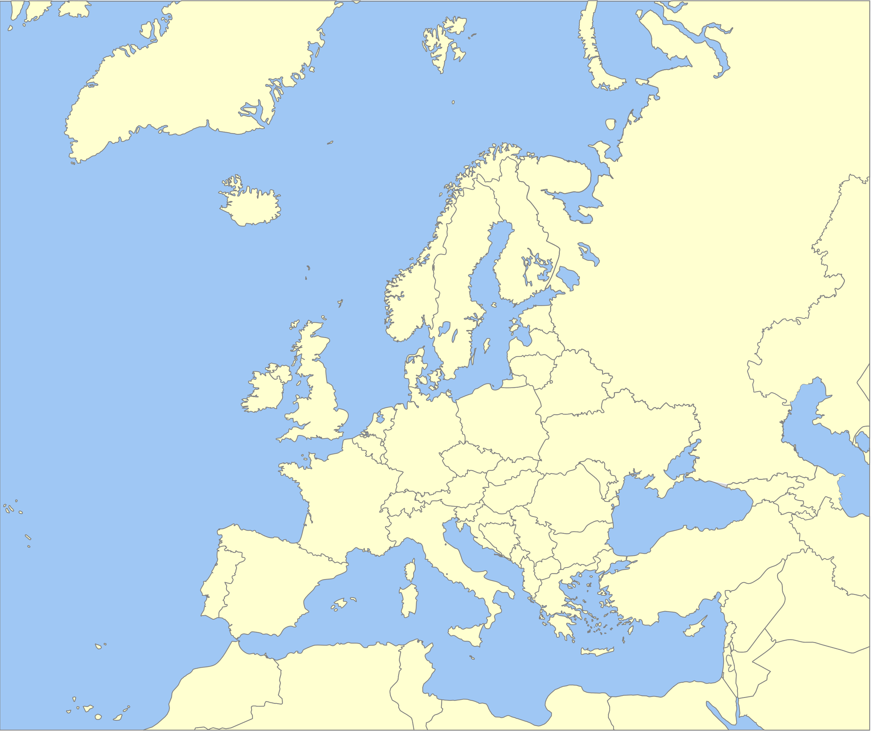





MS of establishment
Nature of transport | occasional carriage of passengers
Carriage route | CZ ➯ PL ➯ DE ➯CZ
Occasional round trip with
local excursions in different host countries
CZ
Warsaw
Berlin
Conclusion
Local excursions within different host MSs performed in the context of an occasional carriage of passengers, with a pre- constituted group of passengers that are picked up and set down in the MS of establishment are not subject to posting rules.
Prague
Notes:
Scenario 6

Slide 45

MS of establishment
Nature of transport | occasional carriage of passengers
Carriage route | DE ➯ FR
Bilateral operation with
local excursions
DE
Frankfurt
Paris
Conclusion
The lack of return of the pre-constituted group of passengers to the country of establishment of the operator does not change the nature of the transport operation and does not trigger the application of posting rules.
Lyon
Bordeaux
Notes:
Scenario 5

Slide 46


MS of establishment
Nature of transport | occasional carriage of passengers
Carriage route | DE ➯ BE➯ FR➯ DE
Occasional round trip
starting and ending in host Member State
NL
END OF POSTING
BEGINNING OF POSTING
Conclusion
Occasional round trip of pre-constituted group of passengers, picked up and set down in the same host MS (DE), so the link to the German market remains evident. Consequently, the driver is subject to posting rules on the entire journey including local excursions in BE and FR. The driver starts to be posted to DE when he crosses the NL-DE border, continues to be posted to DE when in BE and FR, until he sets down the passengers back in DE.
Notes:
This is an occasional round trip for a group of passengers who were pre-arranged and travel together. They are picked up and dropped off in the same location in Germany, which shows the trip is clearly linked to the German market.
Because of this, the driver must follow Germany’s posting rules for the entire trip, including while driving in Belgium and France. The driver is considered to be posted to Germany starting from the moment they cross the Netherlands-Germany border and remains posted to Germany until the passengers are dropped off back in Germany—even during the time spent in Belgium and France.

Slide 47
Scenarios for
posting of drivers
in REGULAR passenger transport

Slide 48
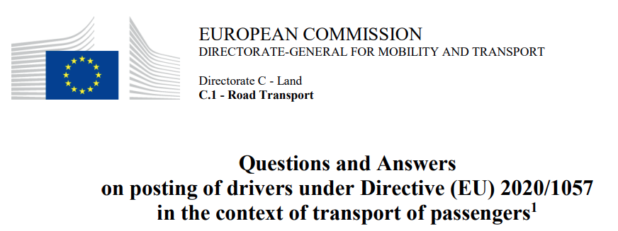
Regular services
In order to assess whether an international regular transport operation is bilateral or not, it is pertinent to assess whether passengers may be picked up and/or set down at a given stop (in line with an authorisation to carry operations in another Member State), and not whether passengers are actually picked up and/or set down at that stop. This is the only way that enable operator to know in advance whether it must submit a posting declaration or not, and the driver to know whether he/she will be posted or not.
Notes:
We assume, that the operator is making full use of the rights granted by the authorisation.
Roadside - tickets

Slide 49


MS of establishment
Nature of transport | regular carriage of passengers
Carriage routes | PT ➯ ES➯ FR FR ➯ ES➯ PT
Regular passenger transport -
A bilateral operation with a cross-trade operation (1+1)
PT
G2V2
Bordeaux
Lisbon
Madrid
Conclusion
When carrying out a cross-trade operation in the context of a bilateral transport operation from the MS of establishment and provided that the vehicle is equipped with a G2V2 tachograph, the driver is exempt from the posting rules. Similar exemption applies on the return journey.

Slide 50



Regular passenger transport - analysis
BORDEAUX
Lisbon
Madrid
Bordeaux
Bordeaux
G2V2
Bordeaux
Madrid
stop for those getting off only
(MS of establishment)
(host MS)
(host MS)

Slide 51
Regular passenger transport - analysis
BORDEAUX
Lisbon
Madrid
Bordeaux
bilateral operation
G2V2
bilateral operation
stop for those getting off only
cross-trade operation
while simultaneous bilateral operation
(MS of establishment)
(host MS)
(host MS)

Slide 52

Regular passenger transport - analysis
Lisbon
Madrid
Bordeaux
LISBON
G2V2
Lisbon
Madrid
stop for those getting off only
(MS of establishment)
(host MS)
(host MS)

Slide 53
Regular passenger transport - analysis
Lisbon
Madrid
Bordeaux
LISBON
cross-trade operation
G2V2
while no simultaneous
bilateral operation
stop for those getting off only
bilateral operation
(MS of establishment)
(host MS)
(host MS)

Slide 54
Exemption rules – summary
(goods and passengers)
1+1
Exemptions from the posting rules during certain
cross-trade operations
  Only if in the context of a bilateral transport operation
  Only if a tachograph is installed
The 0+2 rule applies only to the transport of goods
Does not apply to cabotage operations
Applies to transport of goods and passengers
G2V2
0+2
Applies to transport of goods only

Slide 55



MS of establishment
Nature of transport | regular service
Carriage route | HU ➯ SK ➯ AT ➯DE
Regular passenger transport – cabotage and cross-trade operations in the context of a bilateral operation
HU
G2V2
Stuttgart
Vienna
Bratislava
Munich
Budapest
END OF POSTING
Salzburg
BEGINNING OF POSTING
Conclusion 1
During a bilateral operation between HU and DE, conducted as part of a regular passenger service using a vehicle equipped with a G2V2 tachograph, only the first cross-trade operation (picking up the passengers in Bratislava and setting them down in Vienna) is exempt from posting, under the so called 1+1 rule. Carriage on the route that starts and ends in the same host MS (Vienna – Salzburg and Munich - Stuttgart) is classified as cabotage, which always constitutes a posting situation.
Conclusion 2
In case of regular passenger transport the type of operation is based on a possibility of passengers being picked up and/or set down (according to the authorisation) and not on whether passengers are actually picked up and/or set down at that a given bus stop.
Notes:
During a regular passenger transport trip between Hungary and Germany (HU–DE), using a vehicle with a G2V2 tachograph, only the first pick-up and drop-off of passengers linked to a cross-trade route (Bratislava–Vienna) does not count as a posting situation. This is allowed under the so-called 1+1 rule.
However, transporting passengers within the same country, such as on the Vienna–Salzburg route, is considered cabotage, which always counts as a posting situation.
The final leg of the journey (Salzburg–Munich) is another cross-trade segment, but it goes beyond the allowed exemption limit—so it does create a posting situation.

Slide 56

MS of establishment
Nature of transport | regular service
Carriage route | DE ➯ AT ➯ SK ➯ HU
Regular passenger transport – cabotage and cross-trade operations in the context of a bilateral operation
HU
G2V2
Budapest
Budapest
Budapest
Budapest
Stuttgart
Budapest
Bratislava
Munich
Vienna
Budapest
Salzburg
Conclusion
In case of regular passenger transport the type of operation is based on a possibility of passengers being picked up and/or set down (according to the authorisation) and not on whether passengers are actually picked up and/or set down at that a given bus stop.

Slide 57
Infringements in the area of posting of drivers
TYPE OF INFRINGEMENT | LEVEL OF SERIOUSNESS
 | MSI | VSI | SI
Incomplete information on the posting declaration |  |  | X
Failure to submit a posting declaration to the Member State to which the driver is posted no later than at the commencement of the posting |  | X
Falsified posting declaration for drivers |  | X
Impossibility of the driver to present a valid posting declaration |  | X
Failure to put at the disposal of the driver a valid posting declaration |  | X
Failure to submit the requested documents to the host Member State within eight weeks from the date of the request |  | X
Failure of the operator to keep the posting declarations up to date in the public interface connected to IMI |  |  | X
Information about violations of the posting rules is sent via ERRU to the national registers of road transport operators.
It may lead to the loss of good repute, and consequently, to not meeting the requirements for engagement in the occupation of road transport operator.
Source: COMMISSION REGULATION (EU) 2016/403
Notes:
co-responsibility of other than operator entities
in a transport chain who incited or participated in the infringement, such as shippers, forwarders or subcontractors
Source: COMMISSION REGULATION (EU) 2016/403
Each Member State decides individually on type and amount of sanctions. Sanctions apply to consignors and freight forwarders as well as to contractors and subcontractors
WORKERS ENTITLEMENTS

Slide 58



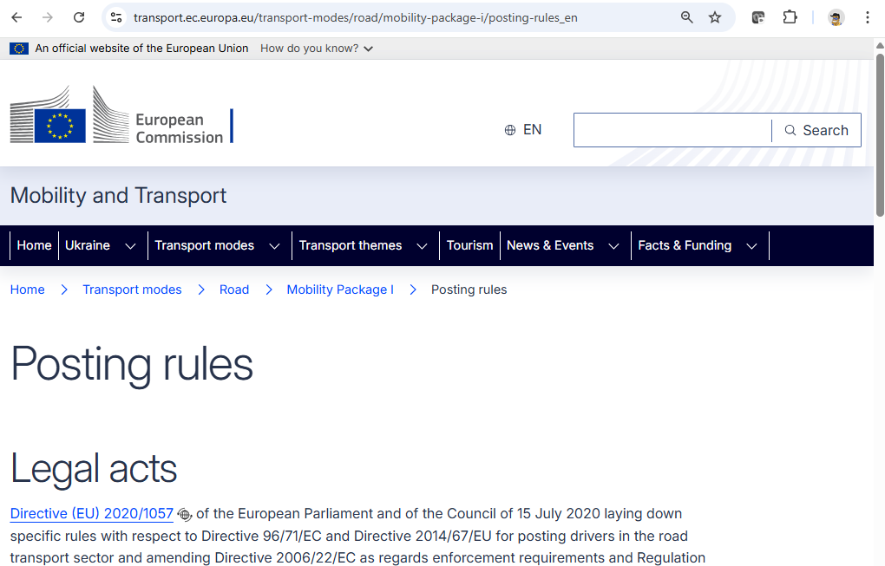
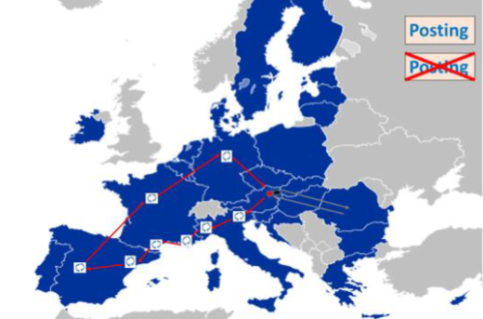
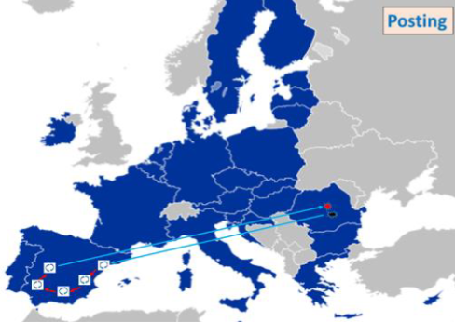
Other sources of information about posting rules
https://transport.ec.europa.eu/transport-modes/road/mobility-package-i/posting-rules_en
POSTING SCENARIOS
Q&As
Q:
A:
Q:
A:
MORE TO COME …
Notes:
ALL EU LANGUAGES

Slide 59
THANK YOU!
www.ela.europa.eu
www.corte.be

Slide 60
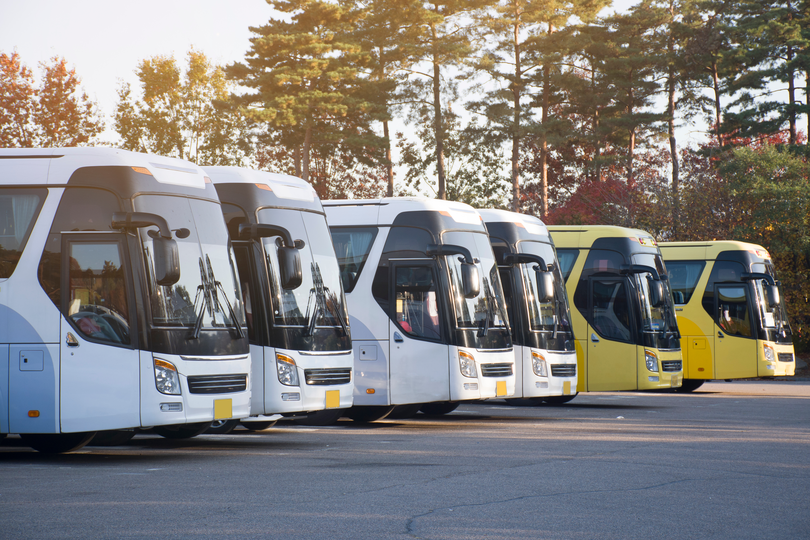
Coordination of Social
Security Systems in Road Transport
Danijela WITTINE
Seconded National Expert,
Cooperation Support Unit, ELA

Slide 61
General principles
  Non-Discrimination: persons to whom the Regulation applies enjoy the same benefits and are subject to the same obligations under the legislation of any Member State as the nationals (Article 4 Regulation (EC) 883/2004)
  Sincere Cooperation: national social security institutions work together to apply EU law (Articles 72 and 76 of Regulation (EC) 883/2004)
  Single Applicable Legislation: Persons shall be subject to the legislation of a single Member State only, the regulation determines which Member State is responsible for social security coverage
  Lex Loci Laboris (place of work) – economically active persons (employes/self-employed) are subject to the legislation of the Member State in which they work; Exceptions: posting, multi-state activity
  Inactive persons –insured in the MS of residence (Lex domicilii – habitual
  residence)

Slide 62
Posting vs Multi-state
 | POSTING | MULTI-STATE ACTIVITY
Regulation (EC) 883/2004 | Article 12 | Article 13
Work situation | Work in another Member State | Normally working in two or more member states
Type of Activity | Exceptional temporary activity | Regular working arrangement
Requested By | Employer in the State of insurance | Worker in the State of residence
Duration | Anticipated duration not longer than 24 months | Issued for a longer period, typically 24 months (no longer than the employment contract), possibility of extension; less administrative burden
Road Freight Transport (2023) | 1.5% of PD A1s issued under Article 12 | 40% of PD A1s issued under Article 13

Slide 63
Multi-state activities–Art. 13 Regulation (EC) 884/2004
Who can be regarded as normally working in 2 or more Member States?
A person who performs one or more activities in 2 or more Member States for the same employer or for various employers.
  Activities performed simultaneously (international road transport driver driving through territories of different MS is a typical example)
  Activities performed in alternation – successive work assignments carried in different MS

Slide 64
Multi-state activities–Art. 13 Regulation (EC) 884/2004
Which Member States legislation applies? Only 2 options:
Member State of residence (habitual residence)
  Substantial activity - (25%) in that MS or work for multiple employers in various MSs (residence = centre of interests)
  Marginal activity disregarded - activities accounting for less then 5% of worker’s regular working time and/or less than 5% of his/her regular overall remuneration
Member State of employer’s seat
  If substantial activity is less than 25% - the legislation of the Member State where the company has its registered office or place of business is applicable
  Place where essential decisions are adopted and where functions of central administration are carried out.
  MS centre of interest of activities - for self-employed

Slide 65
Portable document A1
Certifies MS of insurance – issued by institution of the MS of insurance
Proof of coverage when working outside of State of insurance
  Posting (Art. 12 Regulation (EC) 883/2004)
  Multi-state activity (Art. 13 Regulation (EC) 883/2004)
PD A1 has declaratory, not constitutive character
Should be requested whenever possible in advance

Slide 66
Takeaways
Posting - refers to work on a temporary basis in another Member State;
Multi-State activity - refers to work in multiple Member States as a
regular working arrangement
PD A1 (certificate of coverage) - it certifies that a worker is covered by the social security system of one Member State while working in another EU member state
Apply for PD A1 if the driver is or could be involved in international carriage
Request PD A1 whenever possible in advance
Worker is strongly recommended to carry the PD A1 with him when working in another Member State

Slide 67
Thank you!
Takeaways

Slide 68
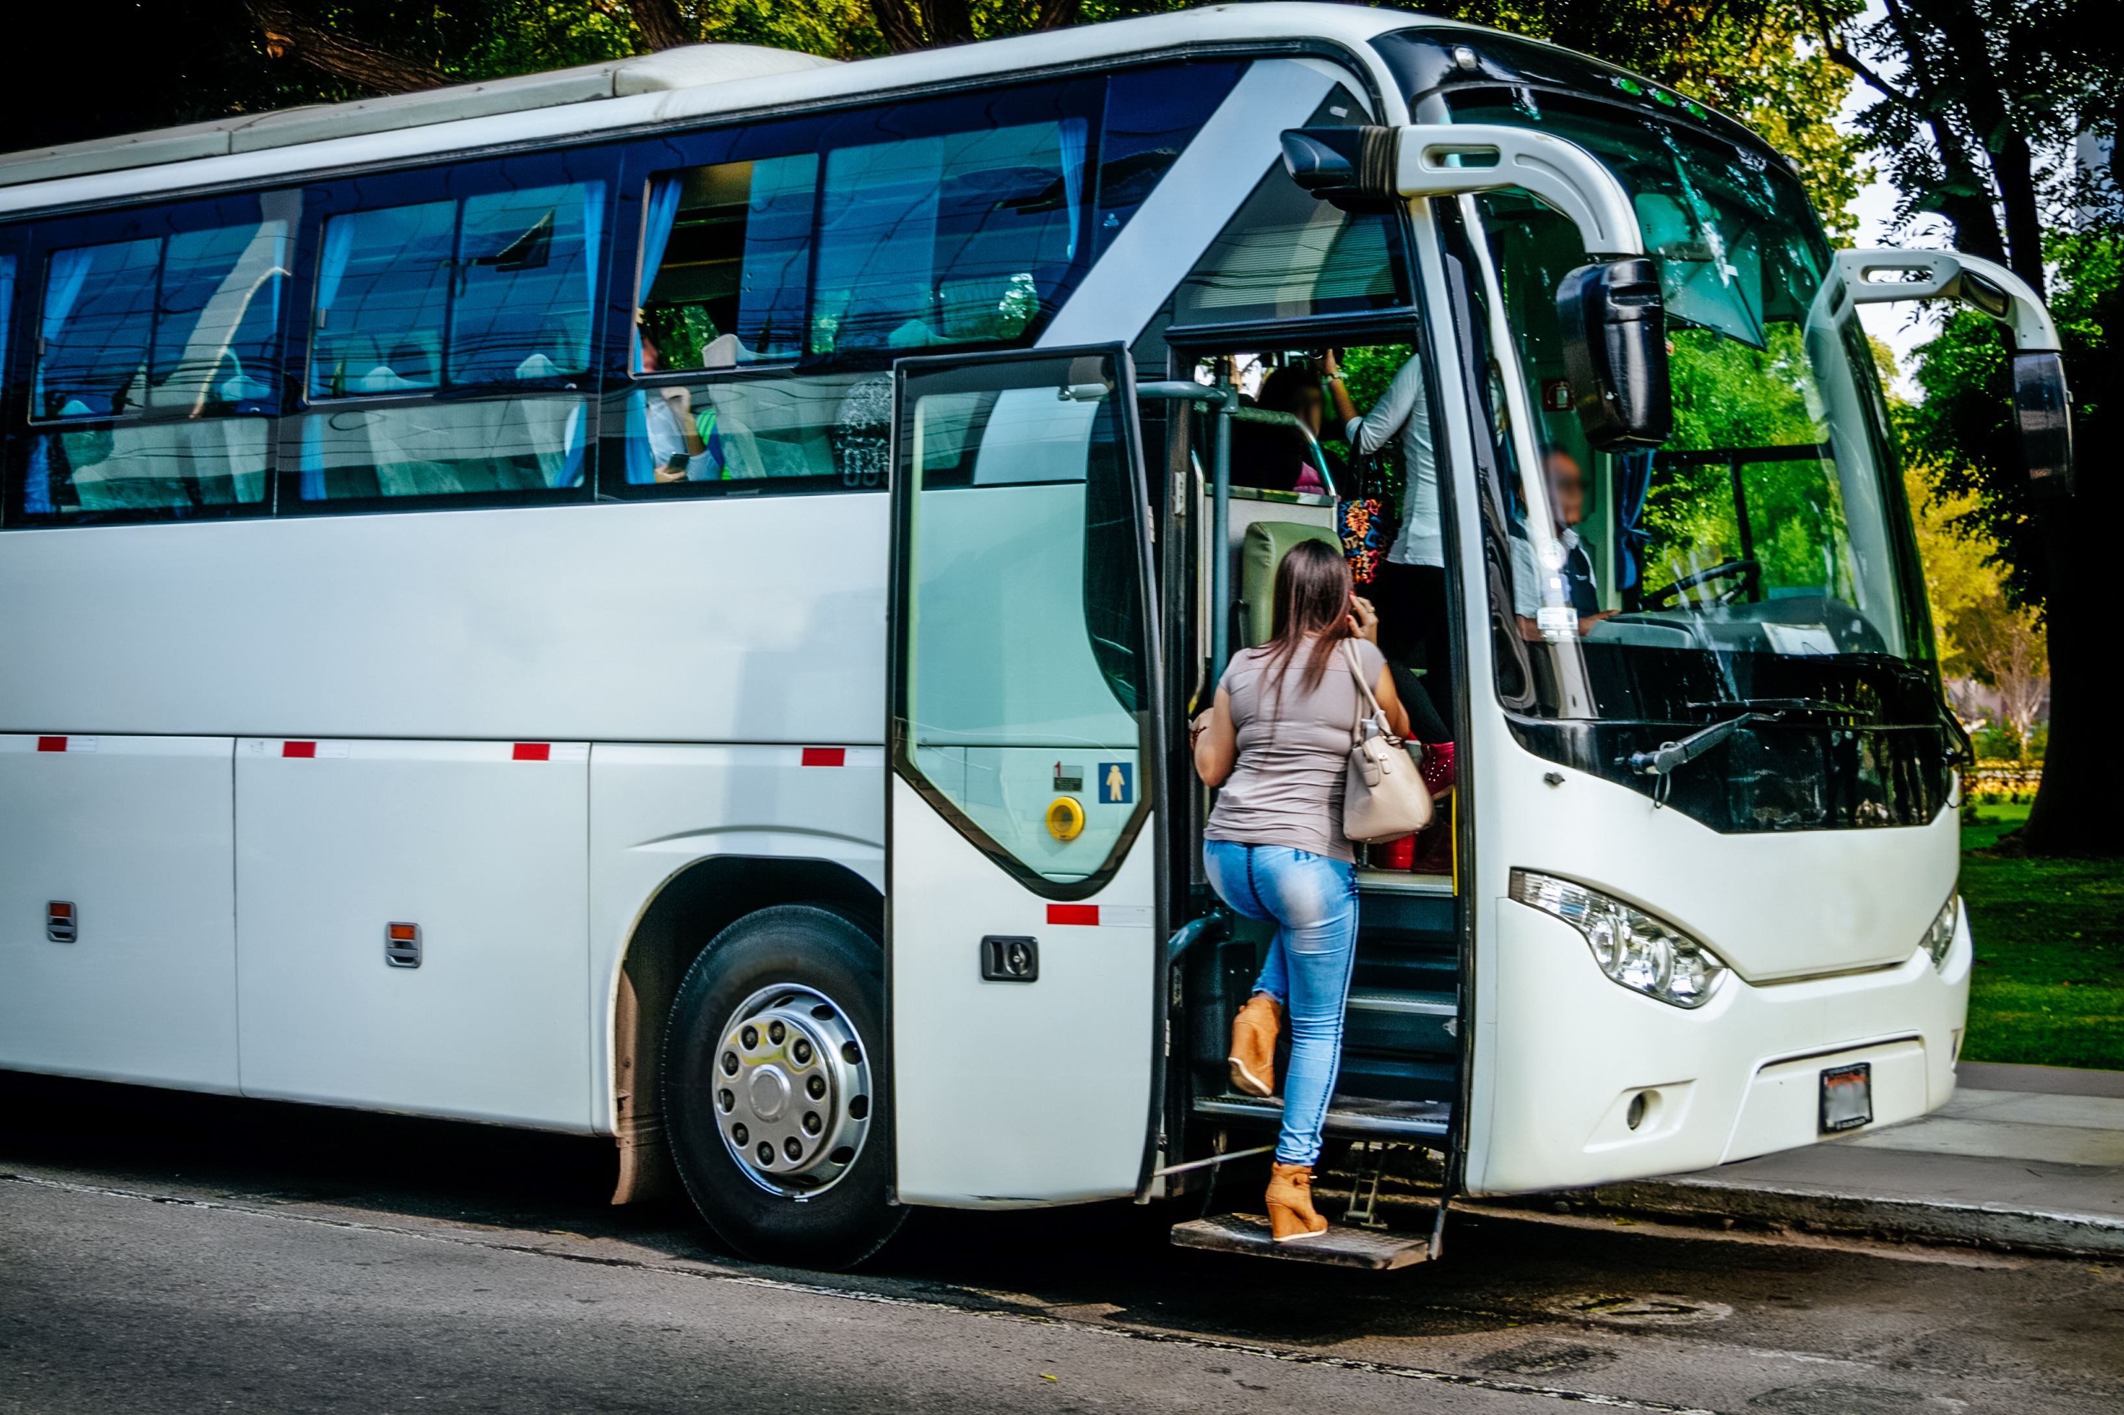
Experience from the side of drivers and operators by ETF and IRU

Slide 69
Discussion

Slide 70
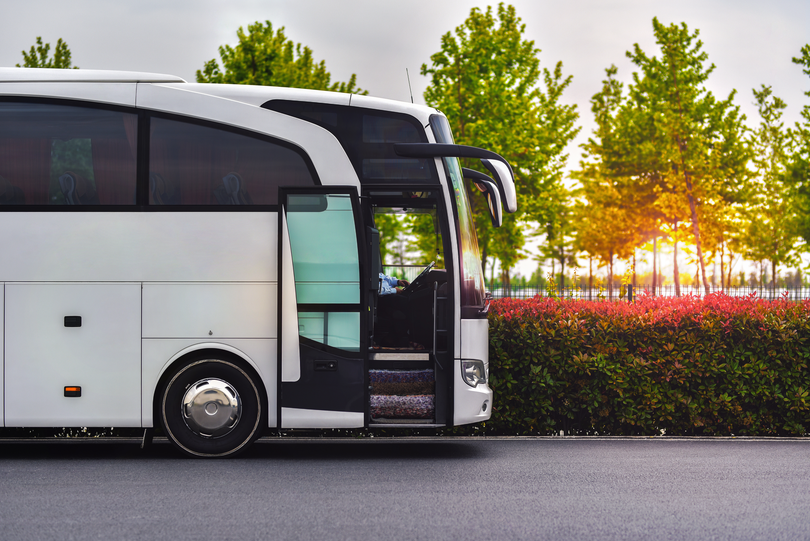
Closing remarks
Iwona KASPRZYK-SOWA
Senior Labour Mobility Officer,
Cooperation Support Unit, ELA

Slide 71
THANK YOU!
www.ela.europa.eu
www.corte.be

